Slide 1


Performance Monitoring Report: 2025, Quarter 3

Slide 2
Contents
Balanced scorecard
Operations: Professional Standards, Registration and Accreditation
External: Communications, Freedom of information
Internal: Human Resources
Finance: Financial performance and outlook
www.arb.org.uk

Slide 3
1. Balanced scorecard
www.arb.org.uk

Slide 4
a. Operations
Professional Standards
www.arb.org.uk

Slide 5
Professional Standards: New case volumes
New complaints, IP referrals and PCC referrals have remained steady, with a slight rise in all areas. We saw the highest number of new cases this quarter than at any time in the past three years (excluding the 2024 reinstatement spike.)

Slide 6
Professional Standards: KPI compliance
The cumulative KPI is now meeting the target, reaching 81% this quarter. This is up 10% on Q2 and follows a trend of continuous improvement since it was established.
KPI improvements reflect targeted work taking place across the department since the start of this year. It has been achieved despite considerable challenges in IP member availability and despite prioritising the delivery of older cases to reduce the age of our PCC caseload.
Screening and Investigations: IP and PCC preparation: PCC listing and closure:
Complaint received to screening closure: 12 weeks Case closures: 12 weeks (case to IP to closure) 18 weeks (Approval of PCC report to last day of hearing) Acceptance criteria met to IP or Registrar: 12 weeks PCC referrals (date sent to IP, to agreement of solicitor's report.):
28 weeks (standard case)
34 weeks (complex case)

Slide 7
Professional Standards: Misuse of title
We saw a peak of new cases in Q2. This was due to the initiation of the Strike Off Audit (SOA)*. New case numbers have now returned to normal levels.
In accordance with our risk-based approach to title regulation, in Q3 we completed phase two and three of the audit. We considered these cases presented a lower risk than those prioritised in Q2 during phase one.
We have seen over 200 re-instatements to the Register since commencement of the SOA albeit we cannot be sure which were a direct result of SOA action.
*The SOA is an annual audit of architects who did not renew their registration at the end of the previous year. We look at whether they are continuing to use the title and take action to prevent title misuse. We take a risk-based approach, prioritising cases where it is clear architectural services are still being provided in the UK.

Slide 8
Professional Standards: Misuse of title
KPI compliance has reached almost 100%. This is despite the high number of investigations required following the Strike Off Audit.
KPI: From receipt to closure or referral to solicitor: 14 weeks

Slide 9
a. Operations
Registration and Accreditation
www.arb.org.uk

Slide 10
Operations delivery: the Register
Our efforts to contact those removed for non-payment has increased the number of reinstatements in Q3.
The age profile of the Register has not changed since Q2, with 6.9% of architects over the UK retirement age

Slide 11
Reasons for resignations YTD
70% of those who resigned so in 2025 were over the UK retirement age
87% of those who resigned gave reasons that suggest they are unlikely to return to the Register in the near future

Slide 12
Operations delivery: applications & removals
With the exception of UK Adaptation Assessments, all areas of Registration activity is on track, or has already exceeded, the expected volumes.
Notably, the volume of reinstatements has exceeded budget by 50% compared to last year
The age profile of resignations continues to show those over UK retirement age are the majority of those who leave the Register. This trend is factored into our expectations for income in 2026

Slide 13
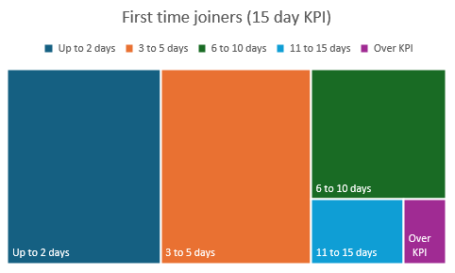
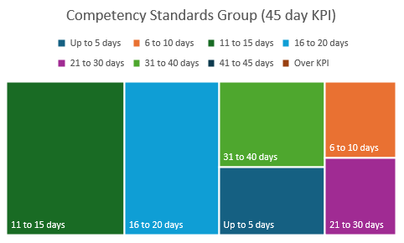
Operations Delivery: Time to join the Register
KPI performance continues to favourably exceed the targets with 96% of those joining the Register for the first time on K/EU/MRA routes doing so in less than 15 days.
The mean and median times are 5.4and 4.0 days respectively
All applications to join under the Competency Standards Group route et the timescale.
The mean and median times for this roue are 7 and 15 days respectively
CRM continues to support effective processing of applications.

Slide 14
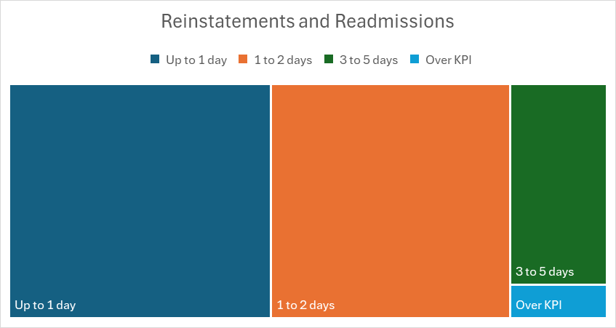
Operations Delivery: Time to Re-join the Register
Despite significantly higher volumes of applications to process when compared to previous years, the KPI for those returning to the Register having been away for less than 2 years, performs well against the 5 day KPI.
Only 26 of the 1122 applications took longer than 5 days to process, meaning 98% of the applications met or exceeded KPI
The mean time to process an application is 1.9 days

Slide 15
Accreditation
The number of existing prescribed qualifications or Providers has not changed since the last update.
We have received applications from 20 different Providers, for a range of qualifications under the new framework
We are on track to assess all Providers against Standard 3 (Governance and Leadership) and Standard 6 (Student Support) this year, as part of the Transition Plan

Slide 16
b. External
Freedom of information requests
www.arb.org.uk

Slide 17
Freedom of Information Requests (FOIs) and Subject Access Requests (SARs) - Statistics 2021-2025 (YTD)
Key Insights for Q3 2025:
Total FOI requests received = 5
Total Subject Access Requests = 3
17% of FOI requests in 2025 (to date) have sought commercial information relating to various operational needs/contract details of ARB.
32% of FOI requests in 2025 (to date) have sought information related to Professional Conduct Cases.
Other FOI requests covered:
Staff expenses and air travel
Generative AI
CPD Requirements
Expenditure on EDI projects

Slide 18
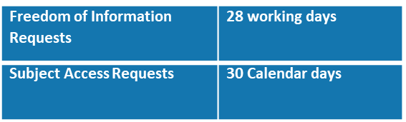
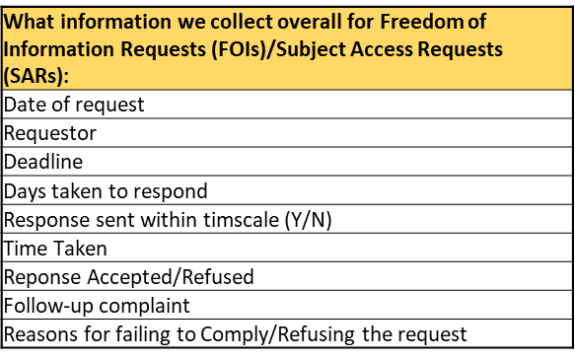
Freedom of Information Requests (FOIs) and Subject Access Requests (SARs) - Statistics 2021-2025 (to date)
Statutory timeline for responses to requests:
30 out of 34 data requests (to date in 2025) were responded to within the deadline. 2 responses are pending final review and will be sent within the deadline. 2 responses to data requests were sent outside the deadline; this was due to staff absences and the complexity of the requests.

Slide 19
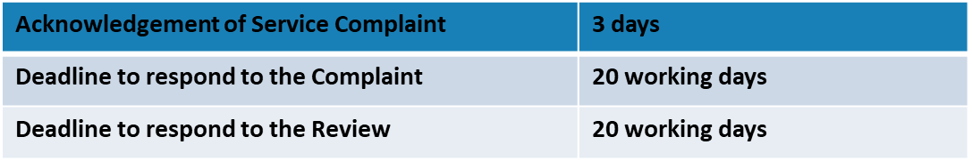
Whistleblowing and Service Complaints Statistics
Whistleblowing instances for 2025 (to date) = 0
Service Complaints for 2025 (to date) = 3
The ARB Service Complaints Policy was reviewed in Q4 2024, and regular reports will be provided to SLG, Audit and Risk Assurance Committee and the Board. The Governance team will capture the following data:
Department for complaint
Response rates (Days taken to respond, deadline for acknowledgement)
Review Stage
Lessons learned
Whether the complaint is upheld
Timeline for Service Complaint responses:

Slide 20
Service Complaints Statistics
Based on the 3 complaints received to date in 2025, we can report the following:
Departments which received the initial complaints – Registration (2 cases) and Professional Standards
Response rates – All complaints acknowledged within 3 working days. The average number of days taken to respond was 18 working days
Review Stage – All three complaints progressed to review stage
Final Outcome – None of the three complaints were upheld following review

Slide 21
Service Complaints Details and Lessons Learned
Nature of Service Complaint | Key elements covered by ARB's response/s | Lessons learned, Actions and Timelines
General (ARB's fees, turnover, value for money, accountability) | Clarifications of ARB's role, responsibilities, relationship with MHCLG, budget and fees | N/A
MyARB Portal/CRM System (fee letters, reminders not received and subsequent removal from Register) | Audit trail of fee and declaration reminders and communications sent; user error identified | Executive to explore whether email verifications systems can be built into the MyARB Portal. These areas will have been explored by the end of Q1 2026
Handling of a complaint against an architect | Clarification of complaints process and parameters of the Architects Act 1997 | Executive to ensure that they continue to carefully explain the complaints process to complainants as their complaint progresses. Executive to ensure robust handover arrangements are in place to cover annual leave periods. This is already underway.

Slide 22
b. External
Communications
www.arb.org.uk

Slide 23
Engagement: meetings and events
Our brand identity is that we want stakeholders to experience ARB as expert, purposeful and engaging. Our strategic aims guiding our communications efforts are that stakeholders understand our role and their responsibilities, and that we have valuable engagement. Valuable engagement means two way conversations in which stakeholders feel heard and ARB gathers useful insights to shape our regulatory approach.
We evaluate our meetings and events by the number we held (as these particular communications activities are two-way conversations), the range of stakeholders reached and, where appropriate, whether the attendees found the event useful. On the Events graph, attendee satisfaction is shown at the top of each column (an average across the events in that period) but we do not poll attendees at every event.
In Q3, our meetings returned to a more normal pattern after the international visits of Q2. Our events in this period included focus groups and reference group meetings for implementing PPE recommendations, our roundtable in Glasgow, and a webinar on the new Code of Conduct and Practice.
92%
85%

Slide 24
Engagement: surveys and consultations
In light of our brand identity and strategic communications aims, we evaluate our consultations and surveys by the response rate (as this indicates how many stakeholders we hear from), the range of stakeholders reached, and whether we gathered useful insights that led to changes or developments in our proposals.
The first graph shows the average number of responses annually across all our consultations and surveys, split between technical (which have a limited scope of interest and/or audiences) and strategic.
The consultation on the second tranche of Code guidance closed in this period. This was a technical consultation and received 11 responses. This was similar to the previous tranche consultation, which received 18.

Slide 25
Engagement: ARB Insight
In light of our brand identity and strategic communications aims, we evaluate the success of ARB Insight by whether registrants are opening (reading) the email and whether they click on links to access more information. These measures are a proxy for evaluating whether stakeholders understand our role and their responsibilities.
ARB Insight is sent out after each Board meeting. The two most popular link in July was the webpage for the new Code, followed by advice for avoiding disciplinary pitfalls, and the latest investigations.
Clicks were slightly higher compared to the earlier issues, but the overall open rate was lower, perhaps due to the summer period.
The new format launched in 2024 reduced the number of articles in the email, to gain more value from the increased open rates. As a result, there are fewer stories to ‘click’ open, and more to read in the body of the email.

Slide 26
Media and social media
In light of our brand identity and strategic communications aims, we evaluate our media coverage by the number of stories that include our key messages (as a proxy for stakeholders reading about and understanding our role) and their sentiment (as a proxy for understanding stakeholder perceptions of whether we are expert and purposeful). We evaluate social media by the number of people choosing to stay informed about our work.
We track the number of stories and their sentiment (average for earlier years, real for in-year quarter)​. The sentiment is tracked manually; a monitoring service alerts us to mentions, but we read each story mentioning ARB and record the sentiment in it.
Social media shows total number of followers and number of impressions across all channels together. Followers carry over year on year, but ‘impressions’ are tracked on an annual basis and will cumulate as we post over the year. These are tracked on the left axis. We also track ‘engagements’ (reactions, shares, clicks and views). Engagements are tracked against the right vertical axis.
Q3 was quieter due to fewer new announcements over the summer period. Our followers continue to rise. We have stopped actively posting on X (formerly Twitter).

Slide 27
Website
Changed approach to data
In light of our brand identity and strategic communications aims, we evaluate the success of our website by whether stakeholders are visiting our sites to access information, which will give them an understanding of our role and their responsibilities.
For the public information pages, we also want to know how long people spent on the pages (as a proxy for the information they consumed and therefore their understanding) and the number of people clicking on to the Register (as a proxy for understanding whether people go on to search for architects).
The home page excepted, the three most visited webpages for this quarter were the MyARB login page, the CPD hub page, and the prescribed exams page. However, our data for visits and engagements is compromised by a cookie issue we’ve detected following privacy policy changes. We changed our approach at the end of August and are monitoring it.
Changed approach to data

Slide 28
c. Internal
Human Resources
www.arb.org.uk

Slide 29
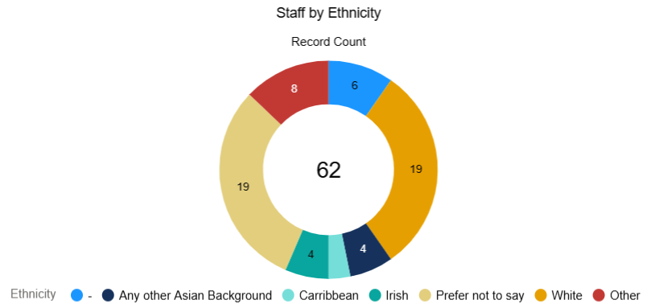
Headcount by Gender and Ethnicity
The budgeted headcount for 2025 is 66, with current headcount in Q3 at 62.
In moving to the Sage People system and using the legal identity reporting category the number of “undisclosed” is high. Categorisation relies on staff to update their identity through the self-service portal. We will be working with staff to populate this over the coming period.
On the ethnicity data collection, those that have selected the “prefer not to say” option and “not reported” (blue) have come down slightly, but again we will need to work with staff to improve data recording and collection to provide a full staff profile.

Slide 30
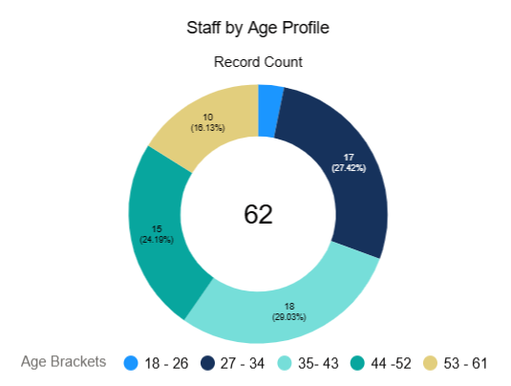
Age Profile for current Staff
The age profile across our headcount of 62 remains static since we last reported and there is an even spread across the age ranges.
This shows that we have a positive recruitment and retention approach across all age ranges.
We will look to provide further analysis on the impact of age profile on for example length of service etc in due course.

Slide 31
Headcount and resourcing costs
Headcount remains within budget, and we are in the latter stages of the Head of Finance recruitment process.
The accruals over Q3 are £1,142,272 and are tracking in line with the year forecast of £4,447,000.

Slide 32
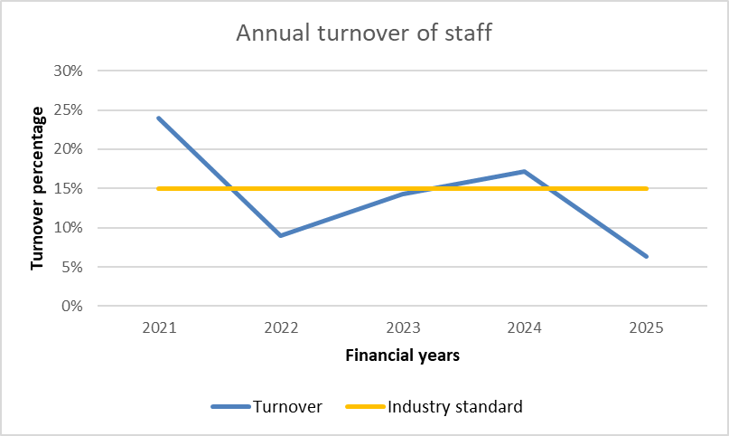
Staff turnover
As has been previously reported, we are slightly above the public sector staff turnover statistic of 15% for 2024.
Turnover for the last quarter is as we might expect and is comparatively lower to previous years.

Slide 33
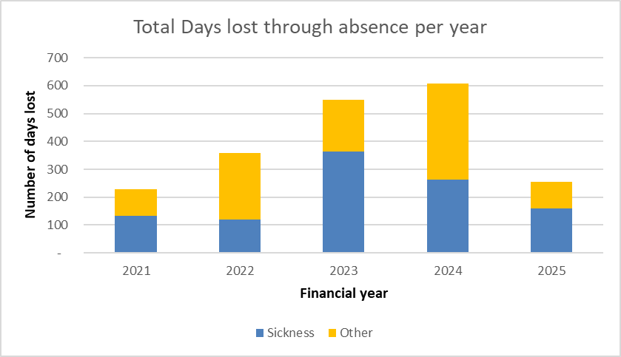
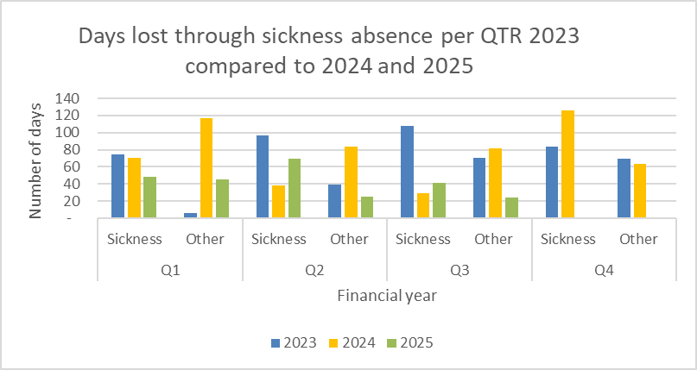
Absence levels
The sickness absence level for Q3 is lower compared to Q2, this is due to a long-term sickness employee returning to work.
The “other” absence level remains the same and is linked to statutory leave (maternity) of our employees.
The data shows positive management of absence where managers through the return-to-work process are working to get employees back to work as soon as is feasible.

Slide 34
d. Finance
Financial performance and outlook
www.arb.org.uk

Slide 35
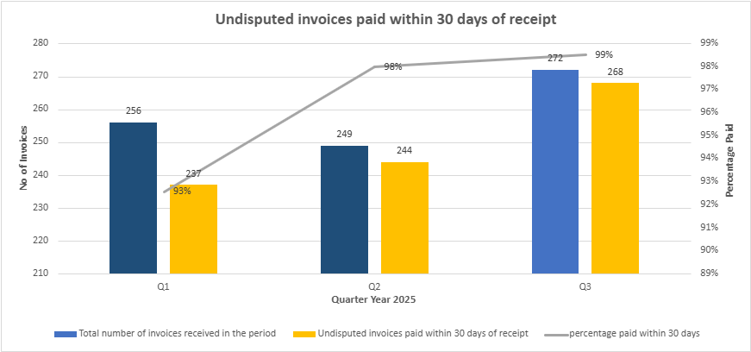
Invoice payments
KPI performance in Q3 2025 was at 99% against an average of 98% in Q2, 93% in Q1 2025 and 92% in 2024.
During Q3, new reporting capabilities were rolled out across all departments, providing detailed purchase order reporting for improved forecasting and budget tracking.

Slide 36

Get in touch
info@arb.org.uk
@archreguk
+44 (0)20 7580 5861
www.arb.org.uk

