Slide 1
Professional Standards Management Information Dashboard- May 2022 Update
Referral activity and KPIs
Annex A
We opened more cases in Q1 of 2022 than during the same period in the previous two years. This currently remains a manageable throughput but will be kept under review.
The number of new title cases is as expected and consistent with last year.
In the last four weeks of Q1 there has been a slight improvement in the IP and combined in-office KPIs. This improvement is not sufficient and so a detailed analysis of cases missing the KPIs has now been carried out, resulting in an action plan to deal with blockages in the process.

Slide 2
Professional Standards Management Information Dashboard- May 2022 Update
Notes on data
Caseload and referral RAG ratings
No apparent risk or concern over caseload or referral numbers
Growing concern over caseload or referral numbers. To be monitored closely.
Caseload or referral rate reaching critical level, posing risk to operational delivery.
KPI RAG ratings
Achieving 80% or above
Achieving between 60% and 80%
Compliance below 60%
KPI timeframes
Initial screening closures*: 14 weeks
Cases investigated*: 14 weeks
IP decisions: 12 weeks
PCC scheduling: 29 weeks
End-to-end: 56 weeks
Title: 14 weeks
*reported as a combined KPI to the Board
NB:
Some of the data sets in these dashboards are areas not reported upon historically. Therefore some 2019/20 data is estimated based on averages of the data available.

Slide 3
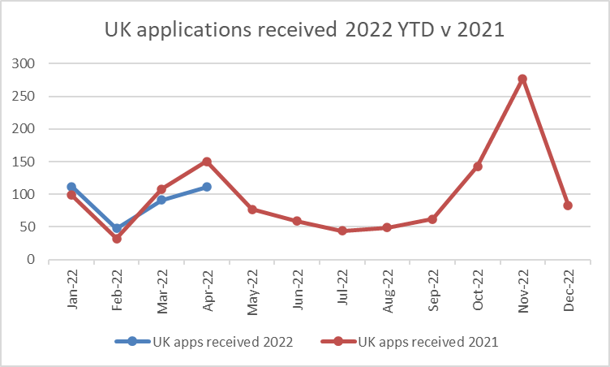
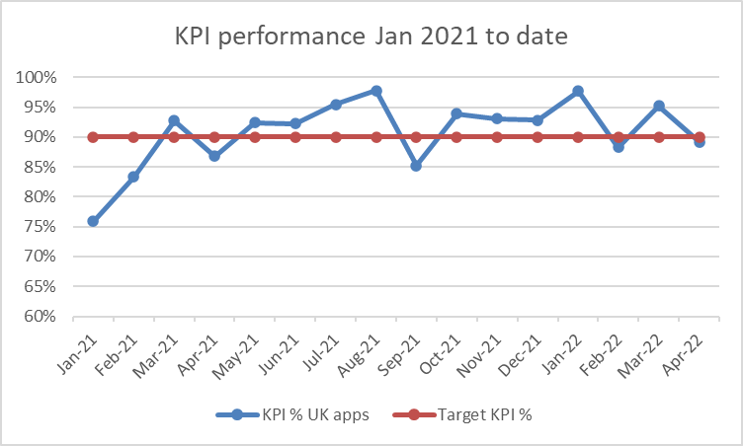
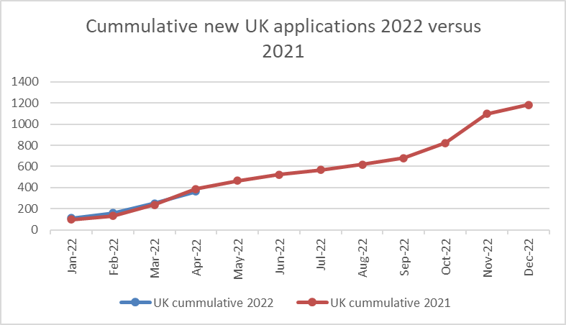
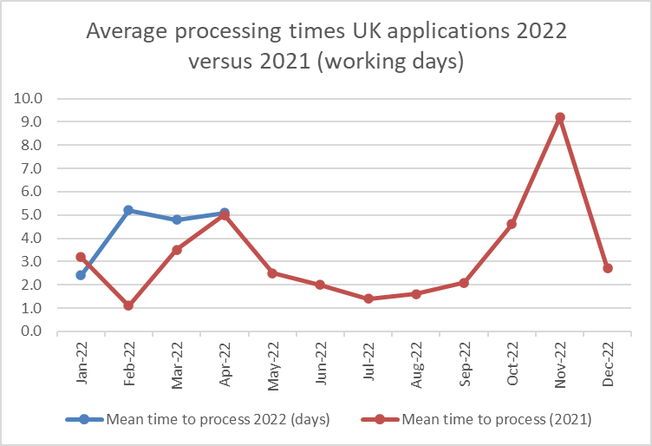
Registration and Accreditation Management Information Dashboard: Q1+ 2022 (January to April)
UK route to registration
Performance update:
New applications are broadly tracking the first quarter of 2021, with a minor decrease in April. There is evidence that this may be due to institutions issuing awards later than in previous years, as May 2022 applications are up on the previous year. Overall the volume assumptions in the budget are holding, with an increase in the prescribed fee for those re-joining the register.
The KPI for UK applications is 15 working days from receipt. YTD the performance is 93%, up from 90% in 2021. We have refined our initial logging and triage process, meaning we can request missing information earlier, and improve customer service with more responsive communications.
The cumulative rate of new UK applications is matching 2021 exactly, and our resource planning is based on this.
There has been an increase in time to process applications, due to missing information. We have enhanced our guidance to applicants. We are still well within the KPI tolerances.

Slide 4
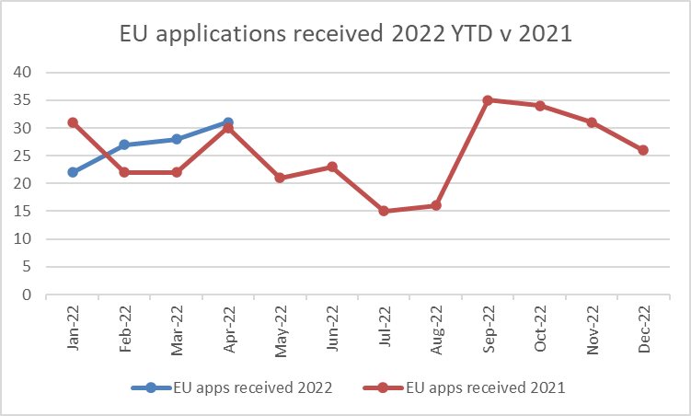
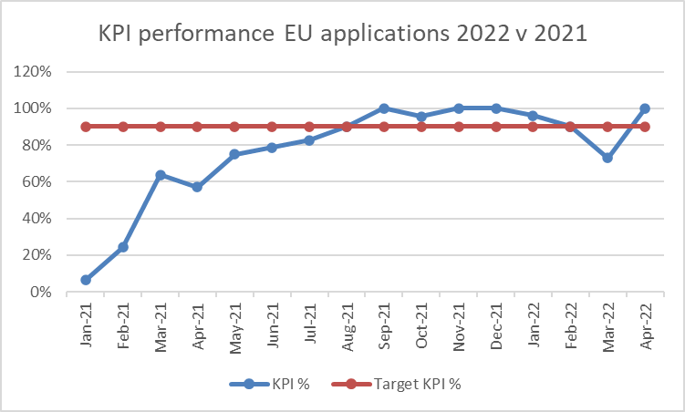
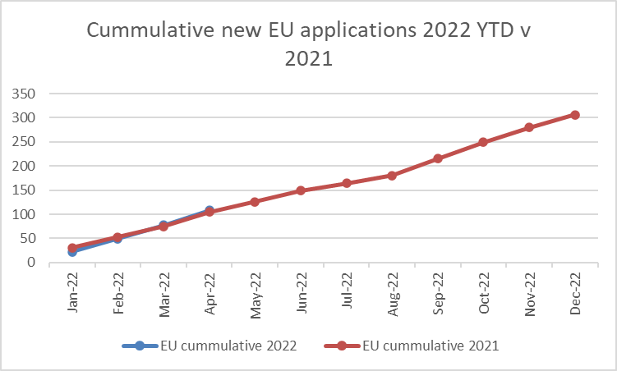
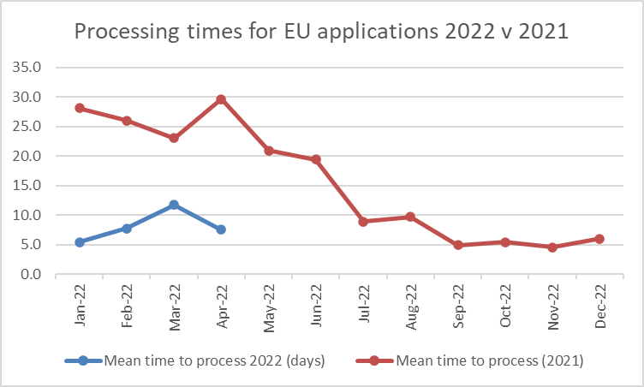
EU route to Registration
Performance update:
There have been three consecutive months where EU applications are higher in 2022 than in 2021. We are also having more enquires from EU applicants about returning to UK Register. We will monitor this through 2022.
The KPI performance has stabilised after a period of complexity associated with the EU Transition period in Q1 2021. Seven of the last eight months have exceeded the KPI target. Low numbers of applications, and small numbers of breaches affect %. There are only 9 EU applications that were not processed within KPI. Those that did not were missing documentation from the home competent authority, who can be slow to respond. YTD there is a marked performance improvement (89% within KPI, versus 59% in 2021), due to our enhanced processes for checking applications earlier.
The cumulative number of EU applications is similar to the pattern for 2021, though there is evidence that EU applications may be starting to increase. Our budget and resourcing assumptions match these levels of activity.
Changes in processing times have been significant, from 25+ working days in Q1 2021, dropping through the remainder of the year, to 8.2 days for 2022 applications. This has been a direct result of earlier changes and chasing missing information, resulting in better customer service outcomes.

Slide 5
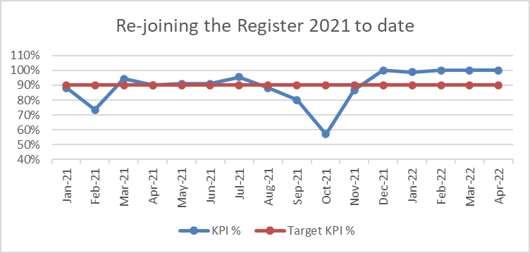
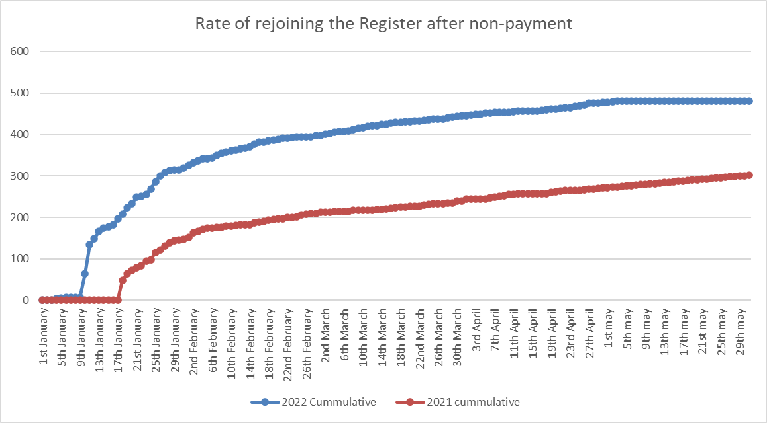
Re-joining the Register
Performance update:
There have been significantly more (almost double) architects re-joining the Register in 2022 than in comparison with 2021. The majority of these were removed for non-payment, despite the campaign of awareness and extended deadline for payment. These attracted the new prescribed fee of £80. We have had four complaints about the level of the fee from almost 500 re joins. 10% of the re-joins were returning to architecture after some time away.
Performance for reinstating these architects has stabilised with five consecutive months of almost 100% compliance, despite the increased volumes. Having a permanent (not temporary) team, and reviewing our processes has yielded this result. We are confident this level of performance can be maintained.

Slide 6
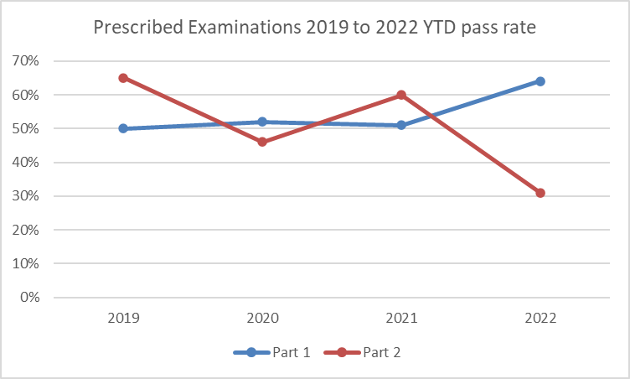
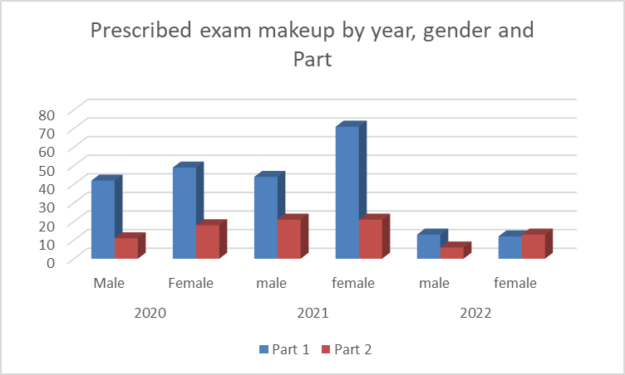
Prescribed examinations
Performance update:
There were 30 Prescribed Examinations in January to end of March, and a further 14 in April. There are a further 25 examinations booked into July, which matches our budget and resource assumptions, and is similar to volumes in 2021.
There are almost equal male to female applicants so far in 2022, whereas females have been higher numbers in previous years.
The pass rate at Part 1 has increased and the pass rate decreased at Part 2. This relates to the re-take numbers in Part 1. We will review more closely the trend in Part 2, by country of applicant, and by stage of failure and report back.
Hong Kong and Chinese applicants account for 25% of 2022 applicants. Another 25% of applicants are UK nationals with a non-prescribed qualification.

Slide 7
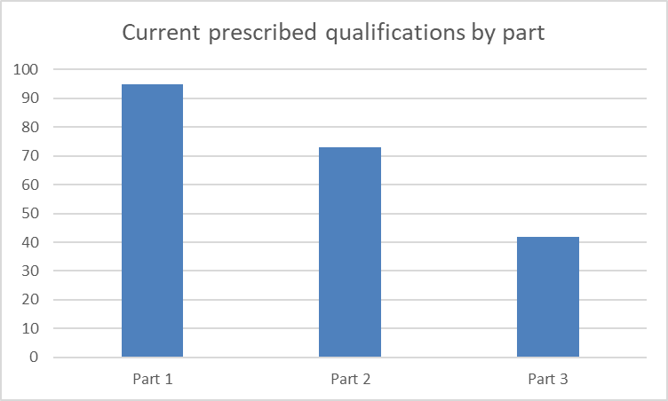
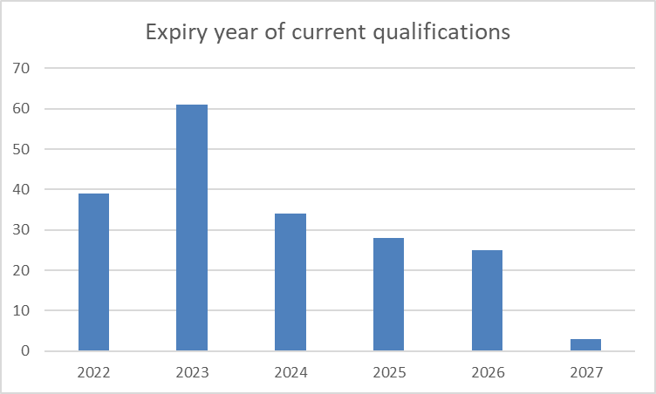
Qualifications
Performance update:
The proportion of Part 1 qualifications remains the same, at 45%. Four new qualifications have been added since the last Board update
The Prescription Committee has met three times so far in 2022, and there is a further meeting in May. This phasing of activity has allowed all Annual Monitoring considerations to be made, six months earlier than the previous cycle. This smoothing of the activity allows a greater, current, view of the institution for the Executive, and assists the institution to focus on their action plans or developments for the next cycle.
In anticipation of IET and any transition of accreditation systems, we have started to analyse the existing qualifications to determine whether any qualifications (or institutions) may be required to extend or shorten their prescription periods. This will help plan activity to bridge the change in governance, and be based on risk assessment of the current performance.

Slide 8
Policy and Communications Management Information Dashboard- Q1 2022
Measures of success: Consultations and surveys | Number and profile of respondents (i.e. whether the respondents are from our target audiences) Whether we have derived insights that support Board decision-making (i.e. whether we know the extent of support for our proposals, or have identified operational or policy risks we can mitigate)
Events and targeted meetings | Number and profile of attendees (i.e. whether the attendees are from our target audiences) Value of insights gathered in the meetings (i.e. whether we hear useful anecdotes that help us understand the sector or policy topics) Whether participant feedback is positive (i.e. satisfaction surveys or positive comments about the event or ARB)
CONSULTATIONS AND SURVEYS | START DATE | CLOSE DATE | RESPONSES
Modernising initial education and training | 2 Oct 21 | 10 Jan 22 | 711
International routes | 27 Oct 21 | 14 Jan 22 | 3
Mixed qualifications | 1 Feb 22 | 28 Feb 22 | 2
Key insights
Modernising initial education and training
Respondents
69% (488): Registered architects
9%: students (including Parts 1 and 2, and Part 3 candidates)
15%: other built environment professionals including architectural designers or consultants
Key insights
Each of the five aspects of ARB’s vision for success received high levels of support (between 92% and 79%)
65% of all respondents agreed the current structure of Parts 1,2 and 3 should change. The extent of the agreement differed: 94% of architecture students, 90% of other built environment professionals and 55% of Registered architects agreed
80% of respondents either strongly agree or agree that the best way to describe the competencies architects need would be to describe what an architect must know, be able to do and how they must behave (i.e. support our outcomes-based approach)
43% of respondents used their written response to suggest how structural change should happen. The most common suggestion was that the practical experience requirements need to change (raised proactively by 19% of respondents)
21% of respondents used their written response to highlight the importance of the competency area of business and practice skills; other topics raised were ethics and professionalism (7%), safety and sustainability.
International routes
Technical consultation so low responses. Of the three responses, two were on behalf of an organisation and one was from an individual. We also gathered detailed feedback which informed the development of our proposals by meeting with interested parties and holding a roundtable discussion. Outcome published on 29 March and emailed to interested stakeholders.
ORGANISATION / EVENT | SUBJECT DETAIL | DATE
RIAI | Intro / catchup | 24 Jan 22
RIBA - Jack Pringle | Alan 1:1 | 10 Feb 22
CIAT | Intro / catchup | 15 Feb 22
CIAT - Kevin Crawford | Alan 1:1 | 21 Feb 22
Bartlett Part 3 Lecture | Annual lecture joint with RIBA Simon Allford | 1 Mar 22
ARB-hosted CPD briefing event on 11 March | Introduced themes from CPD survey to a small group of stakeholders: RIBA, RIAS, RSAW, RSUA, SCOSA, APSA | 11 Mar 22

Slide 9
Measures of success: Parliamentary and stakeholder activities | Number and profile of respondents (i.e. whether the respondents are from our target audiences) Whether we have sent out briefings on the issues (i.e. Bill debates) that matter to us, and whether they have been read and/or resulted in positive comments about ARB or architects Number of primary target individuals or organisations that agree to meet with us
Direct communications | Number of people who open, read and interact with (i.e. click on links in) our relaunched eBulletin. Number and profile of people who act upon our targeted communications (i.e. complete surveys, visit landing pages or download reports).
STAKEHOLDER COMMUNICATIONS | DATE | NUMBER SENT | POSITIVE RESPONSES
House of Lords - Building Safety Bill | 3 Feb 22 | 23 | 6
Update on MRA- Australia and New Zealand | 5 Mar 22 | 4 + website | 2
Introductory meeting offers to MPs and peers | Mar 22 | 40 | TBC
Update on MRA - USA | 17 Mar 22 | Website
International routes - consultation outcome | 29 Mar 22 | 20 + website
REGISTRANT COMMUNICATIONS | DATE | NUMBER SENT | UNIQUE OPENS | UNIQUE CLICKS
ARB Insight | 8 Mar 22 | 44,448 | 24,590 | 4,378
eBulletin average in 2021 | 2021 | 44,007 | 13,852 | 1,994
Key insights
56% of recipients opened the relaunched ARB Insight. On average across all issues in 2021, only 31% of recipients opened the eBulletin. The number of recipients who clicked on links in ARB Insight was more than double the average number for the eBulletin last year.
The most popular link in ARB Insight was the Chair’s Message, with 1,806 unique users clicking on this link.
When we emailed peers in advance of the Bill's second reading debate, we received several thank yous and a positive mention of ARB and CPD work (Baroness Eaton). No concerns were raised about Act changes.

Slide 10
Measures of success Online (website and social media) | Number and (where possible) profile of users who have watched a video, completed a form or survey, read a page, downloaded a report, or requested a meeting. Number of times our online social media posts have been seen and/or shared and/or commented on or have resulted in further engagement i.e. meetings.
WEBSITE | USERS | VISITS (SESSIONS) | PAGES VIEWED | MOST POPULAR PAGE (homepage excluded)
JAN | 22,617 | 33,021 | 73,643 | Public Information - Before hiring an architect
FEB | 19,620 | 27,129 | 62,962 | Public Information - Before hiring an architect
MAR | 22,396 | 30,075 | 87,020 | Architect information - Applying for registration for the first time - I hold overseas non-recognised UK qualifications
REGISTER | USERS | VISITS (SESSIONS) | TOP SOURCES
JAN | 11,010 | 14,572 | Direct*
FEB | 9,462 | 12,346 | Direct
MAR | 14,259 | 17,815 | Direct
Key insights
There were no new publications launched or events held during this period.
When we sent out ARB Insight, we included links to recent updates on our website. Our update about Register after the retention fee period was the main story (other than the Chair’s Message). There were 1,778 unique users who clicked on this link (compared to 1,806 for the Chair’s Message, the most popular link).
*Direct means that the website visit came from typing the URL into the browser or from a bookmark. When Google Analytics is unable to identify the source of traffic, it defaults to ‘direct’.
A session refers to every time that a user has engaged with the website. The users are unique individuals, but they might engage with a page more than once.

Slide 11
Measures of success Online (website and social media) | Number and (where possible) profile of users who have watched a video, completed a form or survey, read a page, downloaded a report, or requested a meeting. Number of times our online social media posts have been seen and/or shared and/or commented on or have resulted in further engagement i.e. meetings.
TWITTER | TOTAL FOLLOWERS | IMPRESSIONS* | ENGAGEMENTS AND CLICKS
JAN | 3,105 | 15,200 | 238
FEB | 3,123 | 5,400 | 139
MAR | 3,154 | 3,809 | 87
Twitter Total | - | 24,409 | 464
LINKEDIN | TOTAL FOLLOWERS | IMPRESSIONS | ENGAGEMENTS AND CLICKS
JAN | 34,722 | 26,649 | 811
FEB | 34,942 | 5,350 | 207
MAR | 35,189 | 12,252 | 372
LinkedIn Total | - | 44,251 | 1,390
FACEBOOK | FOLLOWERS | REACH | ENGAGEMENTS AND CLICKS
JAN | 1,441 | 375 | 65
FEB | 1,443 | 408 | 20
MAR | 1,449 | 468 | 48
Facebook Total | - | 1,251 | 133
YOUTUBE | VIEWS | WATCH TIME (HOURS) | IMPRESSIONS
JAN | 262 | 30 | 566
FEB | 156 | 18 | 476
MAR | 104 | 11 | 425
YouTube Total | 522 | 59 | 1467
*impressions: the number of times it has appeared in someone’s feed
Key insights
Our most popular tweets (based on impressions) were about EDI, recruiting a Chair, and our MRA work with Australia and New Zealand.
Our most popular LinkedIn posts were videos of Elena Marco and Neal Shasore speaking at our education events, and an update on our MRA work with Australia and New Zealand.
We received a high number of impressions in January owing to the popularity of the short videos we produced using footage from the 2021 IET events. One video in particular on LinkedIn caused a lot of discussion in the comment section which caused that post to get a big boost.

Slide 12
Policy and Communications Management Information
Look Ahead to Q2 2022
April | Online event to share CPD survey results with respondents Publication of CPD survey report Building Safety Bill and Professional Qualifications Bill receive Royal Assent
May | Launch consultation on changes to our Professional Indemnity Insurance guidance First focus groups on CPD
June | Second issue of ARB Insight following May Board meeting Online event to share IET survey results with respondents Publication of IET survey report with information about our policy development process (including events and future engagement opportunities) New powers on CPD, listing disciplinary outcomes on the Register and the new Appeals Committee come into force Publication of Annual Report and Financial Statements (subject to dates set by Parliamentary schedule) Potential publication on DLUHC’s review of architects regulation

